Slide 1
NLP and Knowledge Graph Based Analysis of SWECRIS and ERC Database
Capstone- Odd Semester 2023
Guide: Dr. N Arul Murugan
Group 5: Abhishek Acharya (MT22004)

Slide 2
Objective
To extend the work done as IP in Summer Sem, and further analyse the data present in SweCris Database.
Draw conclusions from Knowledge Graphs of diseases, viruses and infections, by taking the words before and after them.
Calculate the frequencies of words associated with each keyword, assigns weights based on the frequencies, and then plot the top weighted words for each keyword.
After doing deep analysis of SweCris database, analyse the ERC database, and perform the same tasks done earlier.
Compare and analyse results from analysis from both databases.

Slide 3
Databases Used
SweCris database
ERC Database

Slide 4
Tools Used
Python Libraries: csv, requests, pandas, matplotlib, nltk, collections, string, networkx
Google Colab

Slide 5
Google Colab Notebooks
https://colab.research.google.com/drive/1ffOY7Yw6tnZNnHm_T_8szeRPUrgJiomm?usp=sharing
https://colab.research.google.com/drive/1osIf5akBiqfsV-pI2f44mkhwWj04G4VE
https://colab.research.google.com/drive/1iIIuuDCQ0ayrB-sKM9yy2EwBMVZ6uR7A
https://colab.research.google.com/drive/1XuQvQ_RihuC7ll8MMaZY9ESUwWy6MFwu?usp=sharing

Slide 6
Work Done
Analysed deeply the SWECRIS Database.
Drawn conclusions from Knowledge Graphs of diseases, viruses and infections, by taking the words before and after them.
Calculate the frequencies word graphs for the database.
Analysed the ERC database deeply, and performed all the same tasks done earlier for SWECRIS Database.
Compare and analyse results from both the databases.

Slide 7
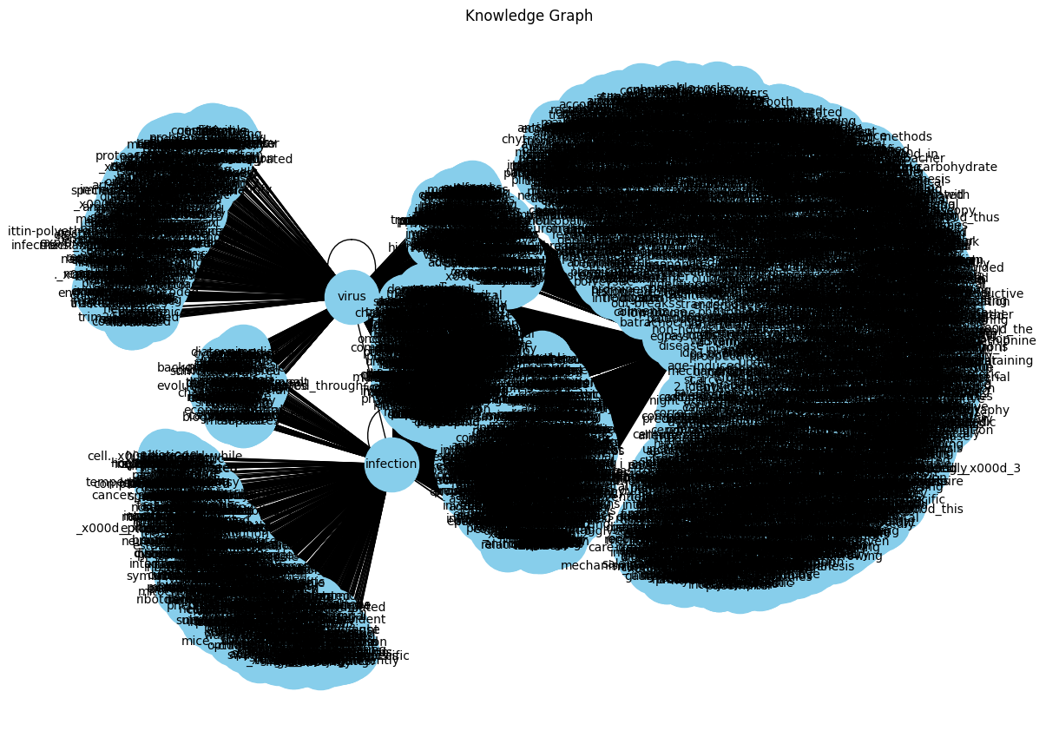
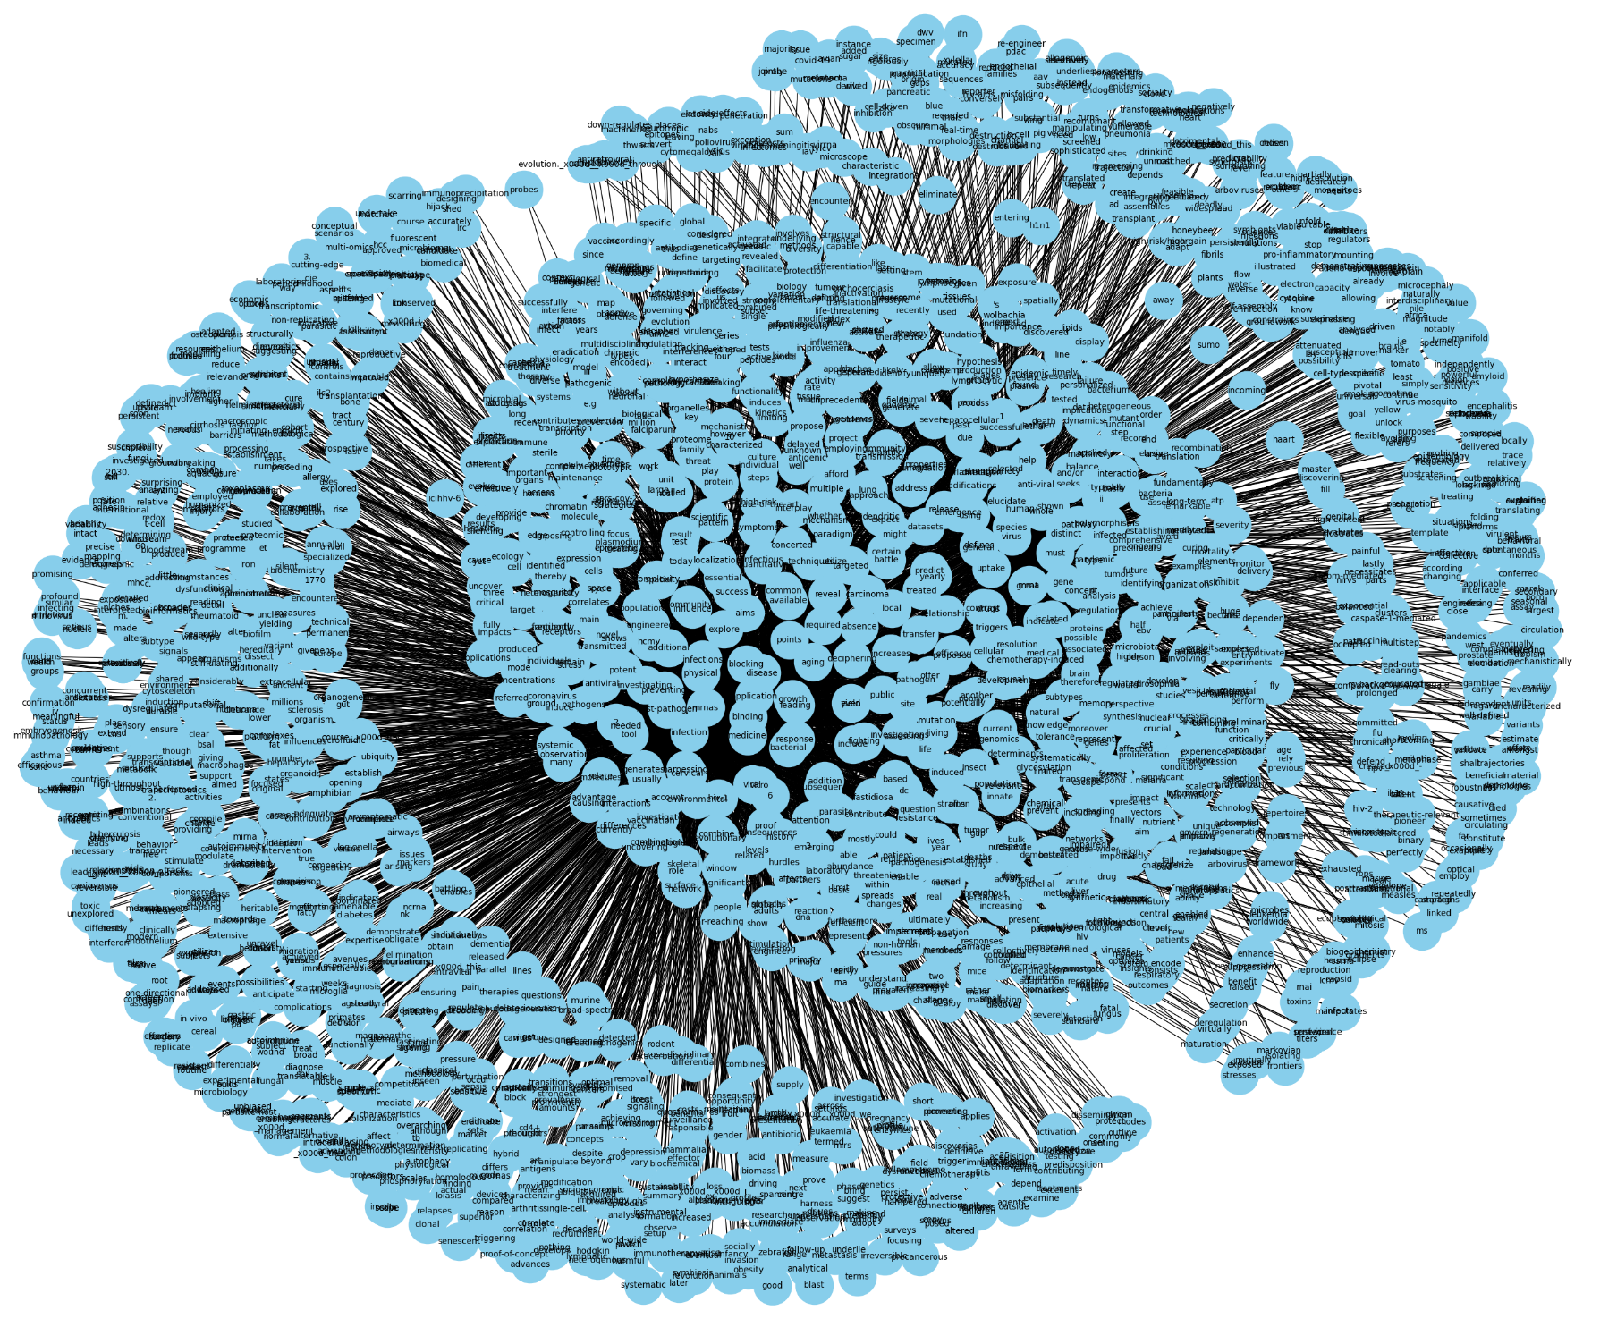
Results
Knowledge Graph

Slide 8
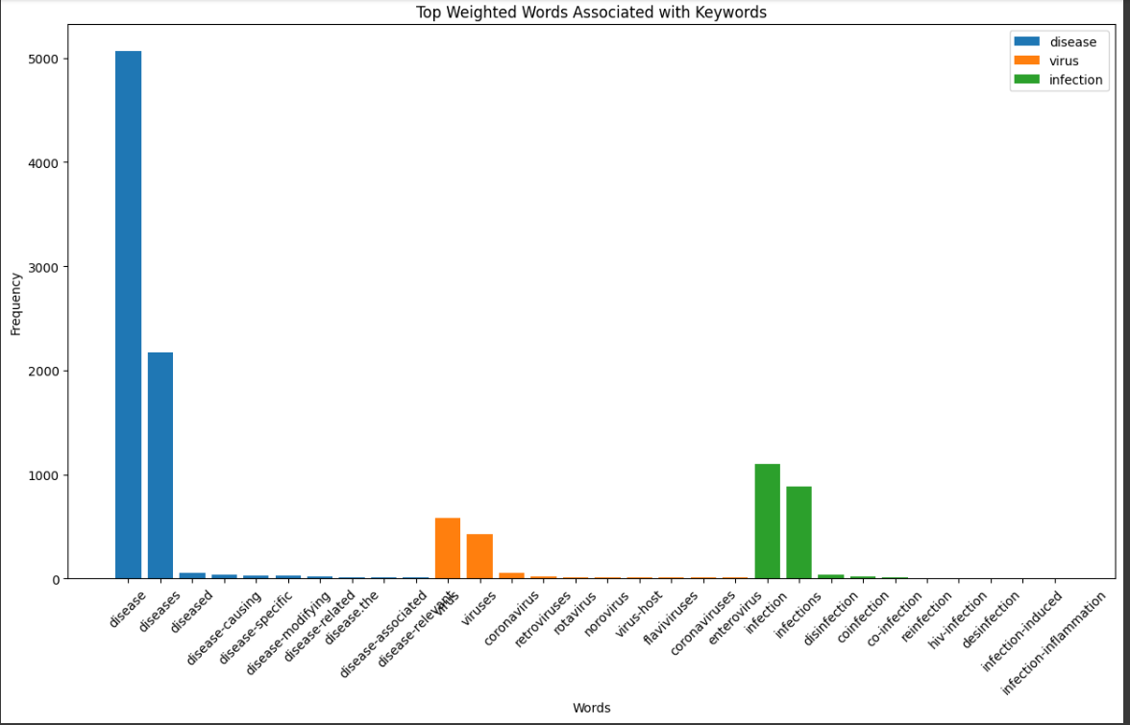
Results (Contd.)
2. Frequency word Graph

Slide 9
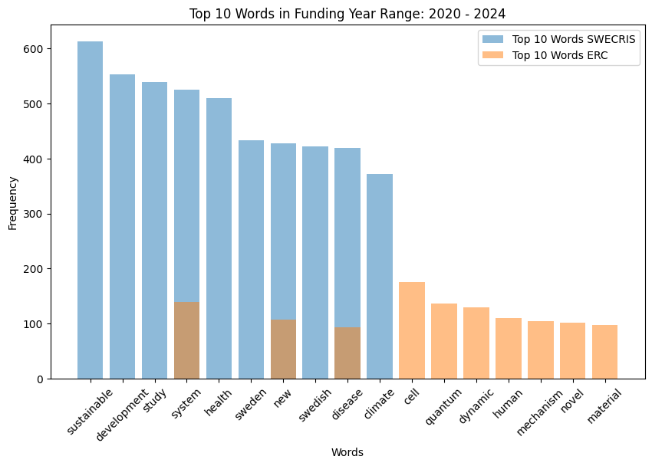
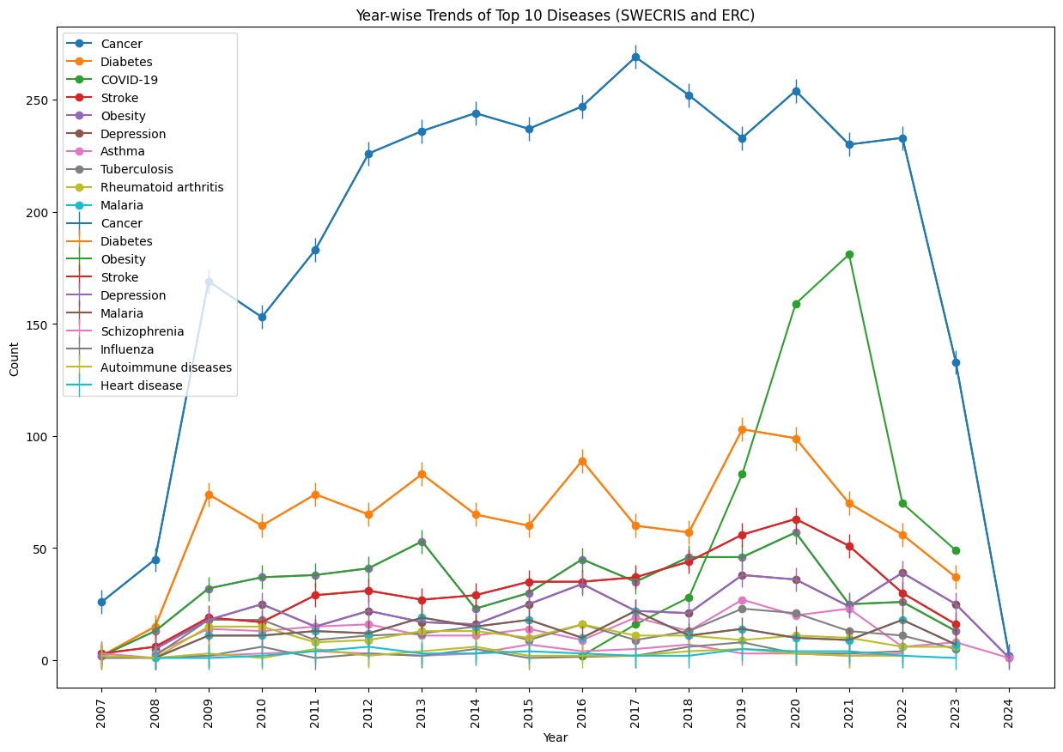
Results (Contd.)
3. Analysis between SweCris and ERC

Slide 10
Problems faced in SERB PRISM Database
The SERB PRISM Database was not available readily, but required Web Scraping using Selenium Automation and BeautifulSoup.
Upon testing the techniques on a similar Census Government Database, it worked correctly. But it failed to work on the SERB PRISM Site. The major reasons for that are:-
Dynamic site, resulting in options of a Drop down not being available to select unless a previous Drop down option has been selected. So, the options in Code gives no such element is present error.
The Submit button has no ID to click. Hence, can't submit the button to actually see the tables.
For some options, there are multiple pages of table, which couldn't be fetched properly.
All Program options are not present for all years, causing some problems of reading blank tables/ no tables.

Slide 11
Future Work and Conclusion
Efforts must be made to extract the entire SERB PRISM Database using Selenium Automation and perform the deep analysis, like the one done for SWECRIS and ERC Databases.
Then, the 3 databases must be compared to get an understanding of the top diseases and the frequency word graph for each of them.
These will help to analyse the trends on the type of projects being done in the world, especially Europe and India. This can help future researchers to take up projects in those particular domains.
Also, the disease analysis (Knowledge Graph and Frequency Word Graph) reveals the major diseases around the globe and specifically Europe and India. This will help understand the trend of diseases and may also reveal some patterns to protect humans from future diseases, by trying to treat the existing ones.

Slide 12
Thank You

